Slide 1

Deploying Spring – JAR/Kubernetes/docker (Spring chapter 18)
Group: Nathan Salazar, Tim Klimpel

Slide 2

Deployment Options
Spring boot offers several deployment options:
Traditional Java application: deploy application to Tomcat, WebSphere, WebLogic involving a WAR file.
Cloud platform: deploy application to cloud foundry, amazon web services (AWS), and google cloud platform usually with a JAR file.
Using maven to produce Container image that can be deployed anywhere that containers are supported.

Slide 3
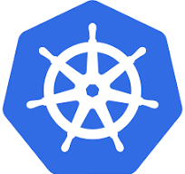
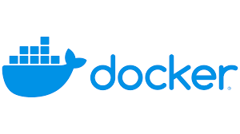
Focus on Docker and Kubernetes
Kubernetes:
Kubernetes Is a container- orchestration platform that runs images, handles scaling up and down, and has increased robustness for containers.
Platform to run distributed systems that provides the building blocks for building developer platforms.
Docker:
Docker is a containerized application that has a standard size and format that makes it easy to be shipped and deployed to multiple environments that supports docker.
Docker integration with spring makes it easy to create your own container.

Slide 4
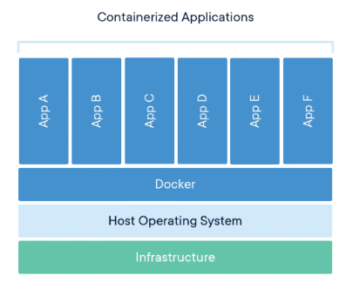
What is Containerization?
Containerization is software that packages code and its dependencies and lets you easily move them between one environment to another.
They are abstractions of the app layer that packages code and dependencies together.

Slide 5
Docker Pros and Cons
Docker Pros:
Cross platform Consistency which allows docker to be compatible from a range of systems.
High speed deployment: Eliminates redundant installations which makes development faster and easier.
Docker cons:
Docker may have security issues due to the lack of segmentation. Important to be aware of this when using docker.
Limited Orchestration: difficult to manage multiple containers without orchestration capabilities.

Slide 6
Kubernetes Pros and Cons
Kubernetes Pros:
Provides a framework to run distributed systems resiliently to takes care of scaling and failover for your application.
Provides service discovery load balancing, storage orchestration and automated rollouts and rollbacks
Kubernetes Cons:
Kubernetes is not a traditional, all-inclusive PaaS (platform as a Service).
Does not deploy source code and does not build your application.
Does not provide any comprehensive machine configuration language/system.

Slide 7
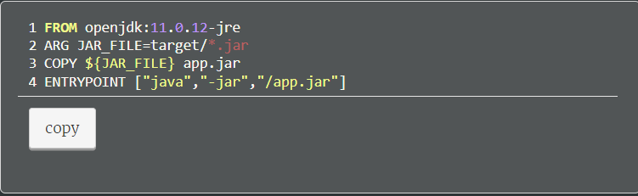
Working with Docker
Docker images are defined from a file named Docker file.
With the Docker build command will create a Docker build command.

Slide 8
Building the Docker Image
Build the docker image using the docker command line tool.
With spring you use the build-image goal from the spring boot maven plug.
In the command above the –t argument is the image tag, which is made up of a name and version.
You can now check the newly created image with the following command.
The –p8080:8080 in the above command request the port to 8080 on the host machine.

Slide 9
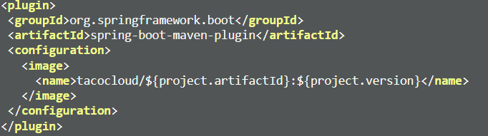
Spring boot maven
Spring boot comes with features that allow you to avoid hardcoding artifact IDs and versions.
Changing the projects Pom.xml file as follows allows for this in the configuration block.

Slide 10
Build the image
Now you may build the application at the command line with specifying image name.
This image created can now be pulled and run from any environment that has access to the registry.
Kubernetes is a great place to deploy an image!

Slide 11
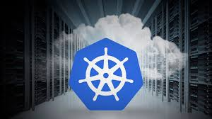
Kubernetes
As previously mentioned, Kubernetes deploys your applications.
Several options to get a Kubernetes environment which include Amazon's AWS EKS and google Kubernetes engine for full production.
To run locally you only need Kubernetes implementations such as MiniKube.

Slide 12
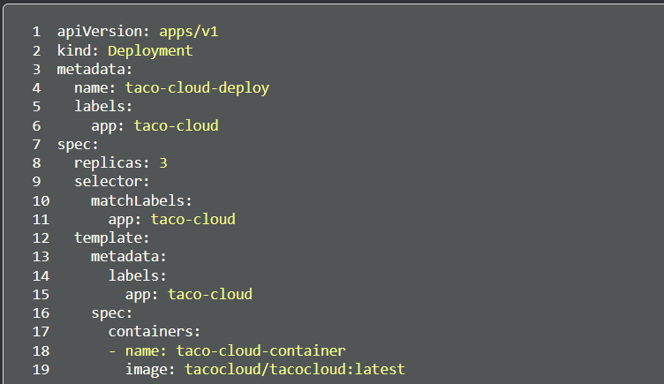
Working with Kubernetes
Kubernetes needs a manifest in a YAML file which will describe how an Image should be deployed.
Example:
This file needs to be placed at root of the project for development to be successful

Slide 13
Apply development
Use the command-line tool to deploy the project.
After deploying you can now see the deployment running and depending on how many replicas you requested.
Now try out the application, expose a port from one of the pods on your machine with the following command:

Slide 14
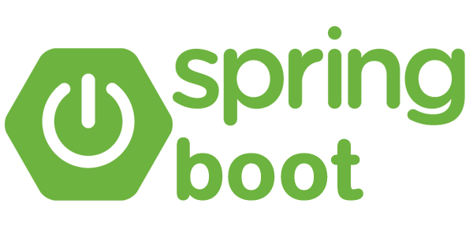
Why deployment with spring
Spring application can be deployed in several different environments, including traditional application servers such as PaaS.
Containerizing spring applications is a simple as using the spring boots build plugin support for building images.
Deployment of these images can be used anywhere and as described in this presentation.

Slide 15
Live Demo

Slide 16
Resources:
Getting started: Spring Boot Docker. Getting Started | Spring Boot Docker. (n.d.). https://spring.io/guides/topicals/spring-boot-docker
Overview. Kubernetes. (n.d.). https://kubernetes.io/docs/concepts/overview/
Walls, C. (n.d.). Chapter 18: Deploying Spring. In Spring In action (6th ed.). essay, Manning.

